Slide 1
ECON 620 Development Economics Rudolph Monsio Bropleh, Ph.D. School of Graduate & Professional Studies
Lecture Notes on POVERTY

Slide 2
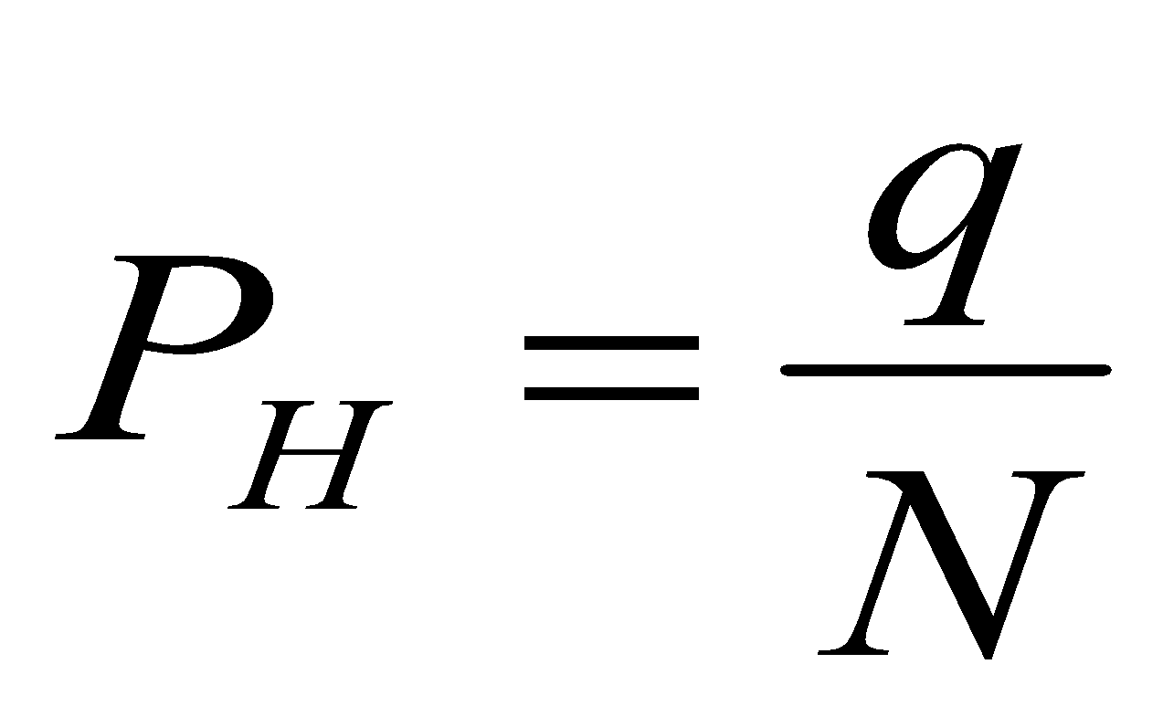
Measuring Poverty: The Headcount Index
q = Number of people with income below the poverty line (which we’ll call z)
N = Total population (the max that can be in poverty—if everyone were poor)

Slide 3
Advantages/Disadvantages
Easy to calculate
Just need z, q (add up how many people are in households below the poverty line), and N.
Insensitive to how far below the poverty line the poor people are.

Slide 4
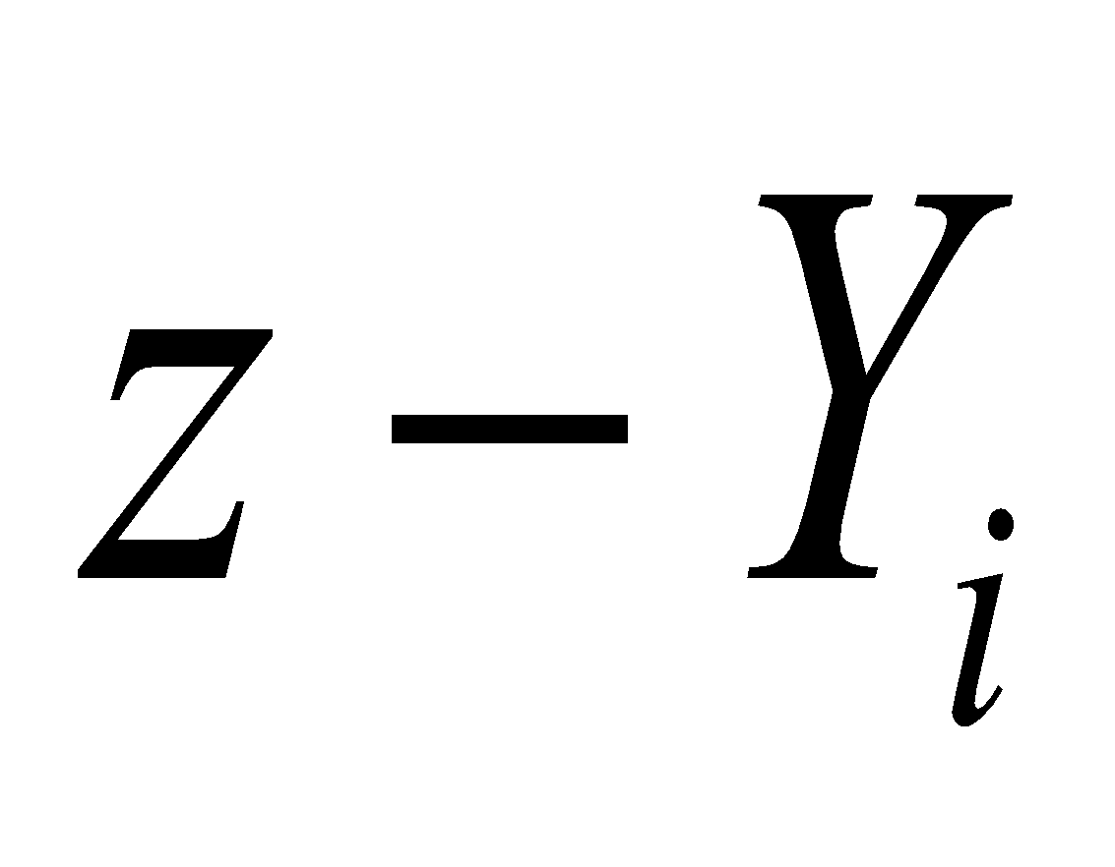
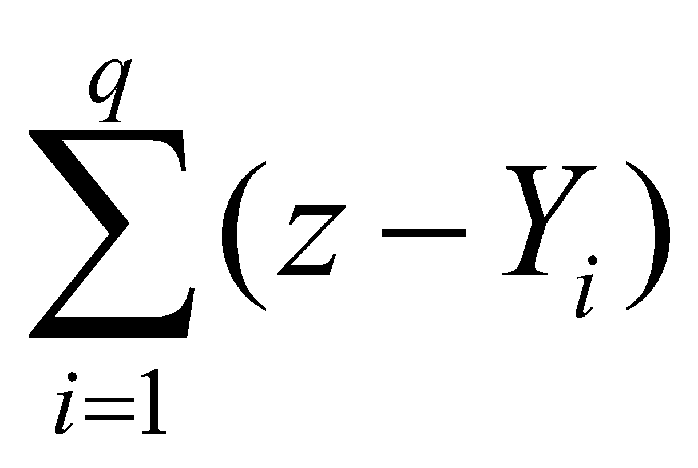
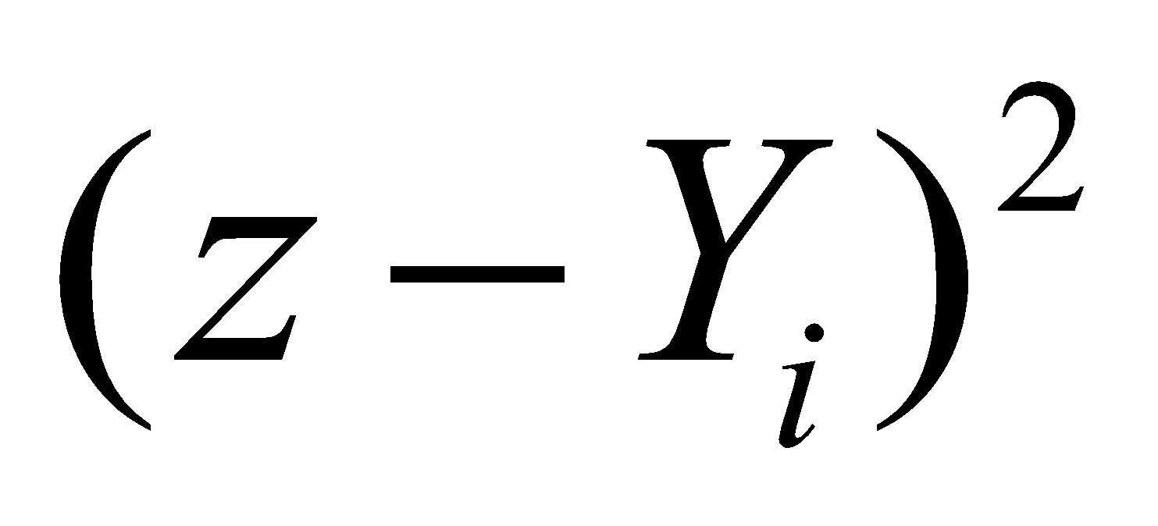
The Poverty Gap (Depth) and Gap-squared (Severity)
For person i:
Total Poverty Gap:
Poverty Gap-Squared

Slide 5
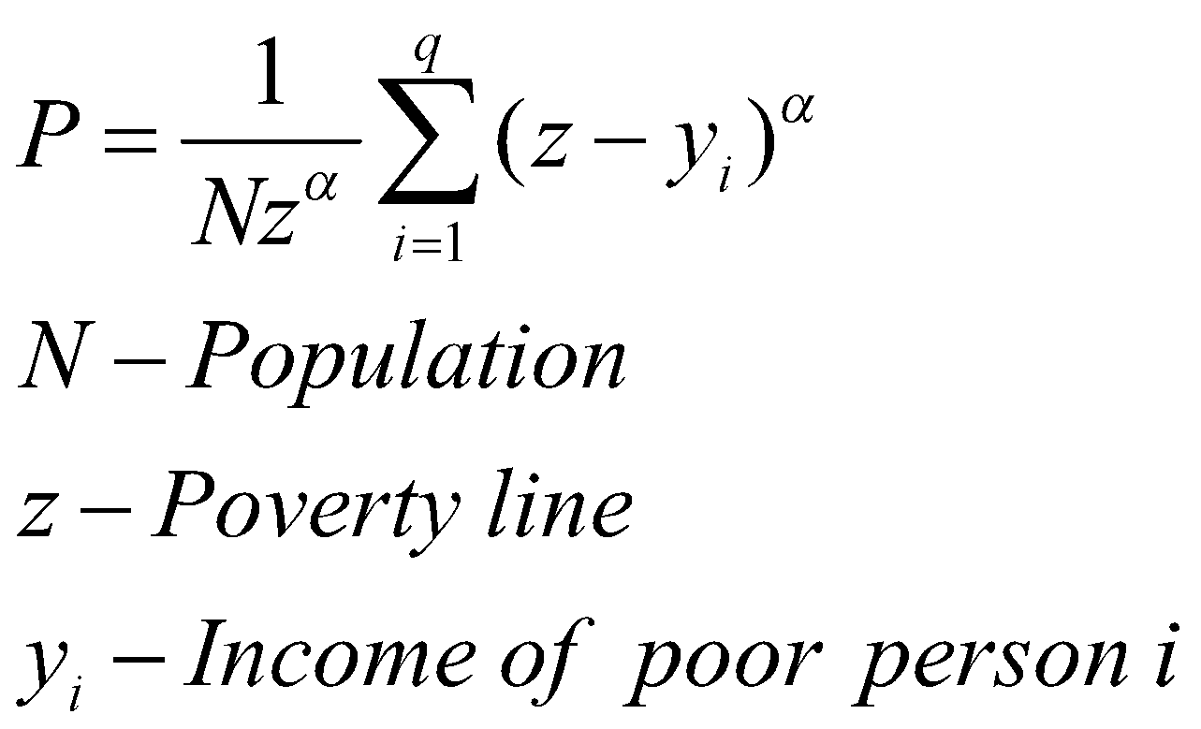
Measuring Poverty: FGT
Headcount
Poverty Gap (Depth)
Severity of Poverty
3 in One: The Foster-Greer-Thorbecke measure (ranges from 0 (no poor) to 1 (everyone’s poor with zero income))

Slide 6
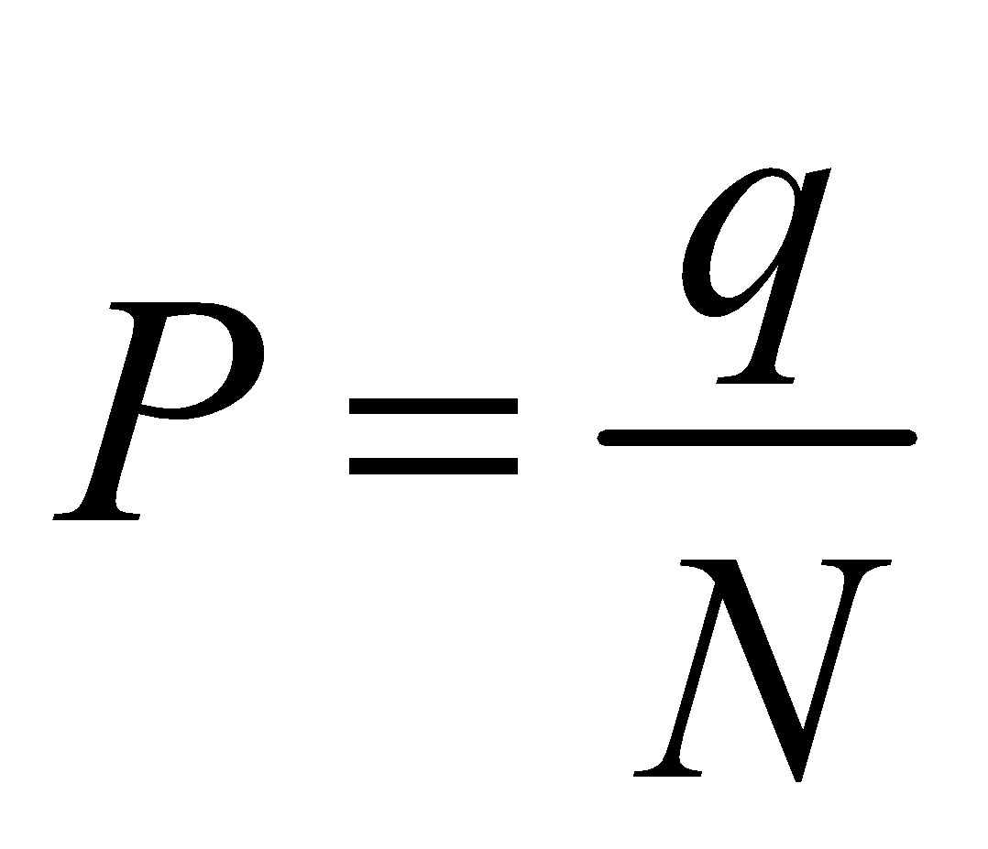
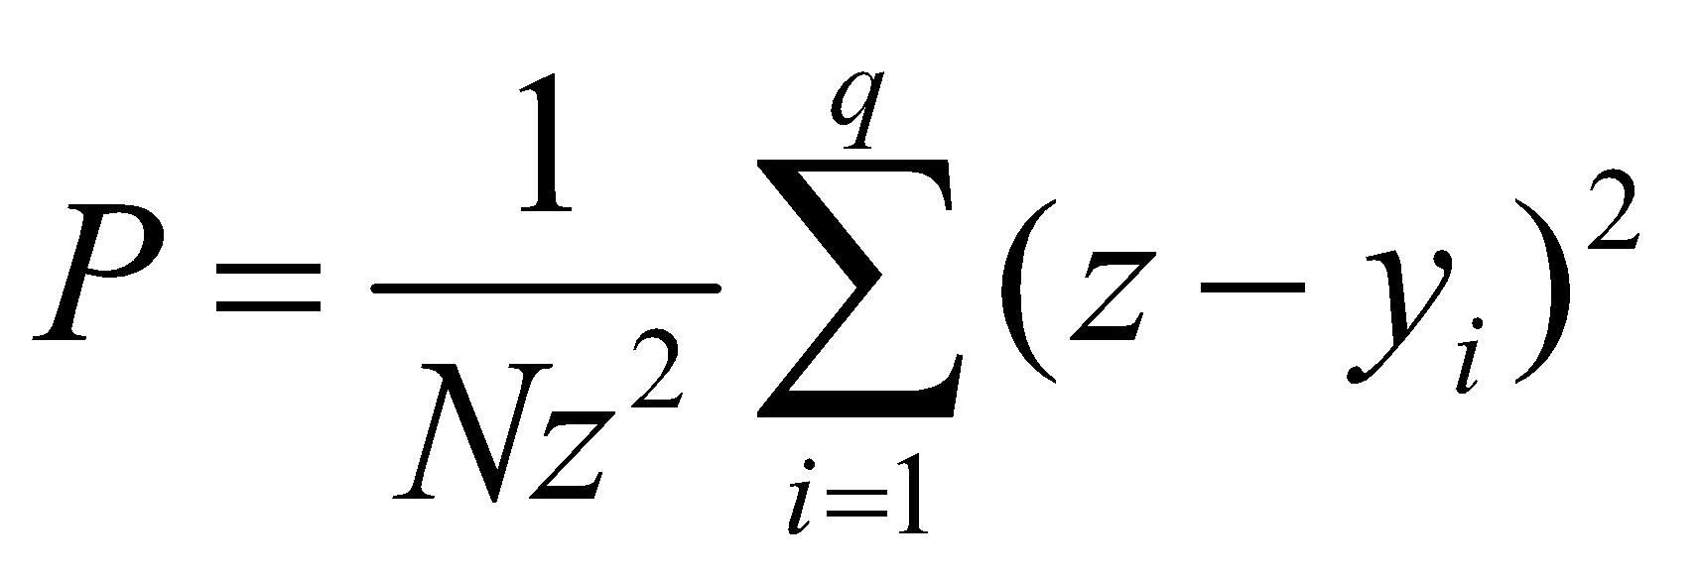
The Three FGT Measures Derived from:
Headcount (α=0):
Poverty Gap (α=1)
Poverty Severity (α=2)

Slide 7
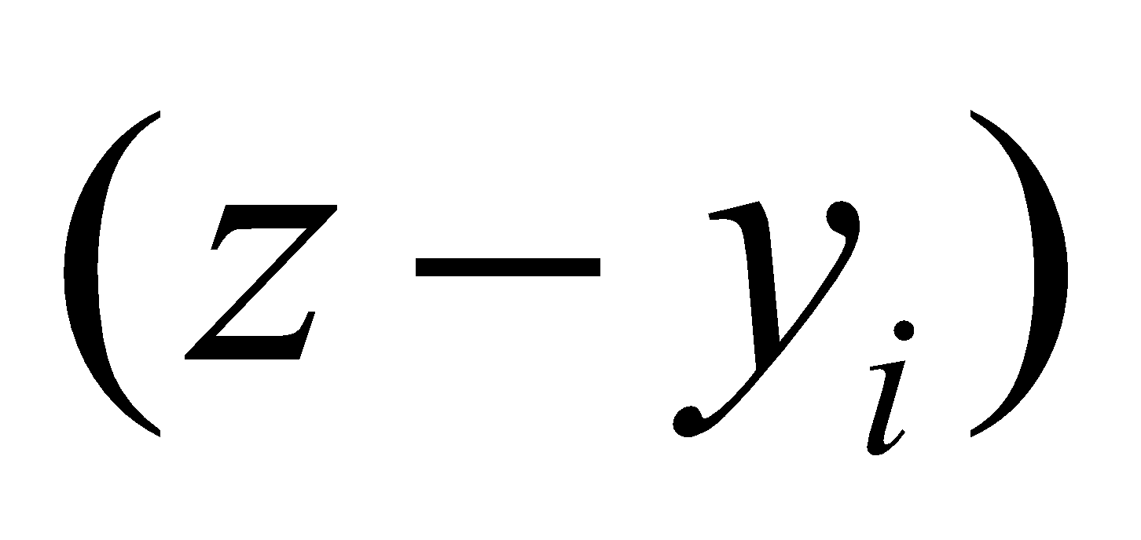
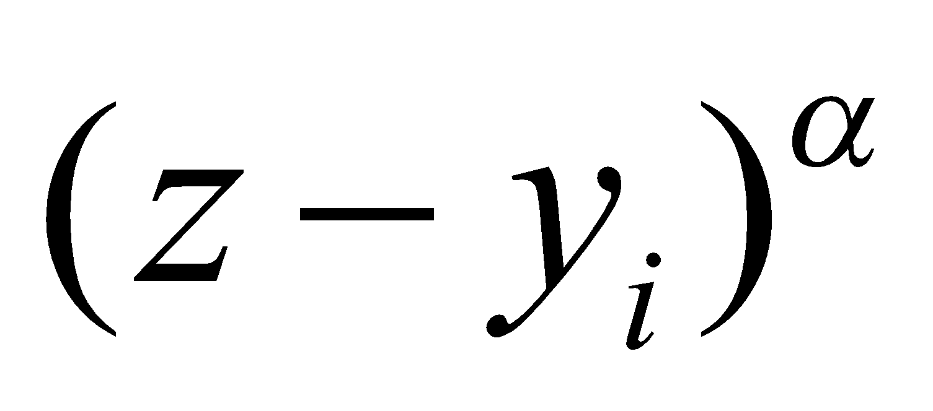
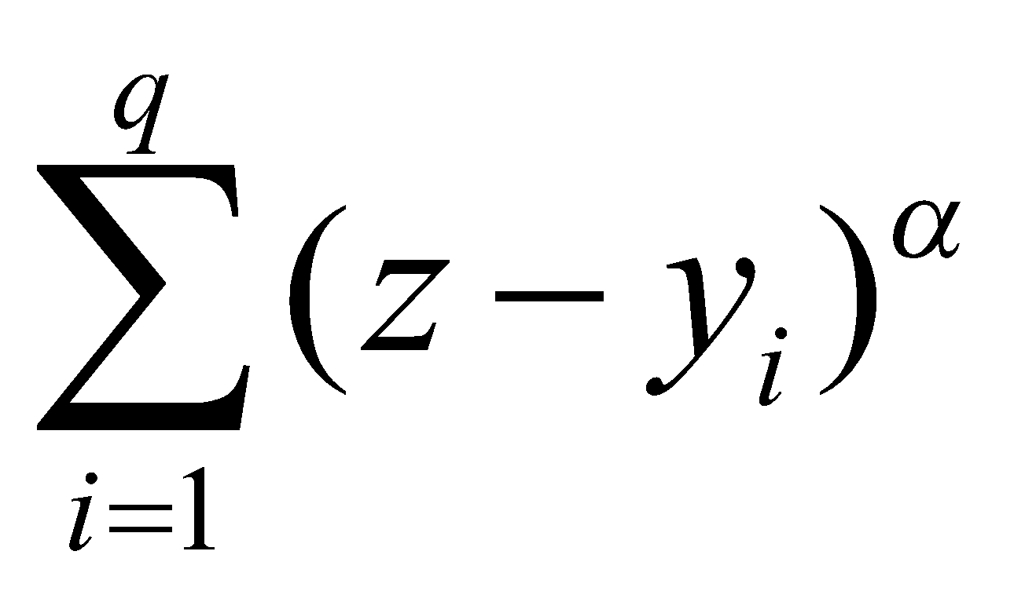
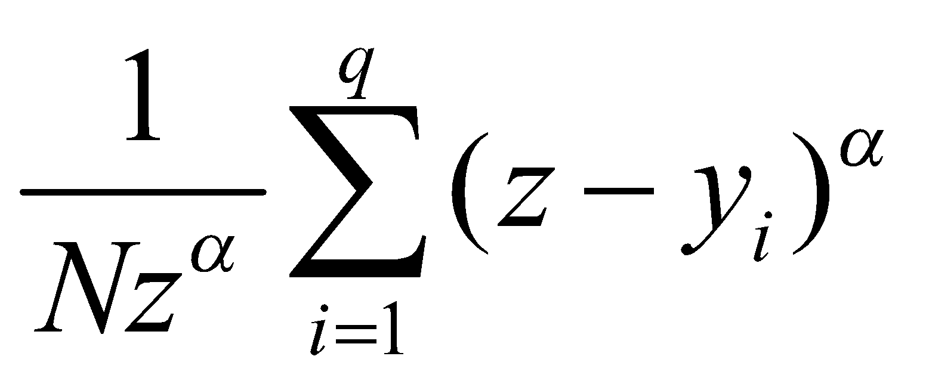
Recipe for Calculating the FGT
1. For each POOR household (y_{i}<z), calculate the poverty gap:
2. Raise it to the α power:
3. Take the sum (Σ) of gaps across all q poor households (add ‘em up):
4. Divide by (multiply by 1 over) Nz^{α}:

Slide 8
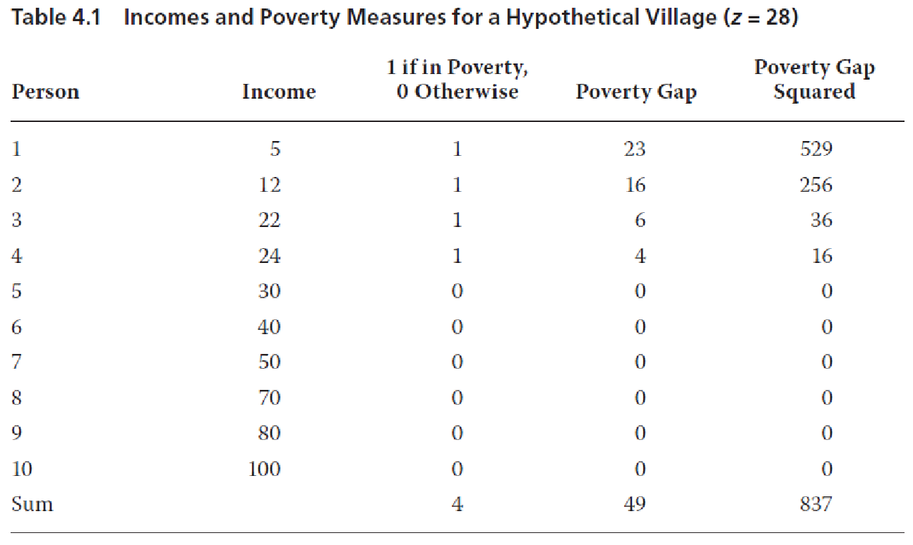
FGT: An Example

Slide 9
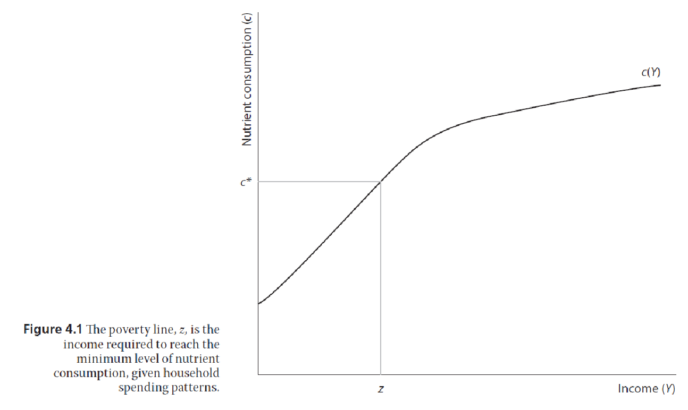
Where’s the Poverty Line?
-Average developing-country z: $2/day (PPP adjusted)
-U.S. poverty income for a family of 4 in 2012 was $23,050 (15.79/person/day)

Slide 10
Poverty Dynamics: It’s Harder than You Think

Slide 11
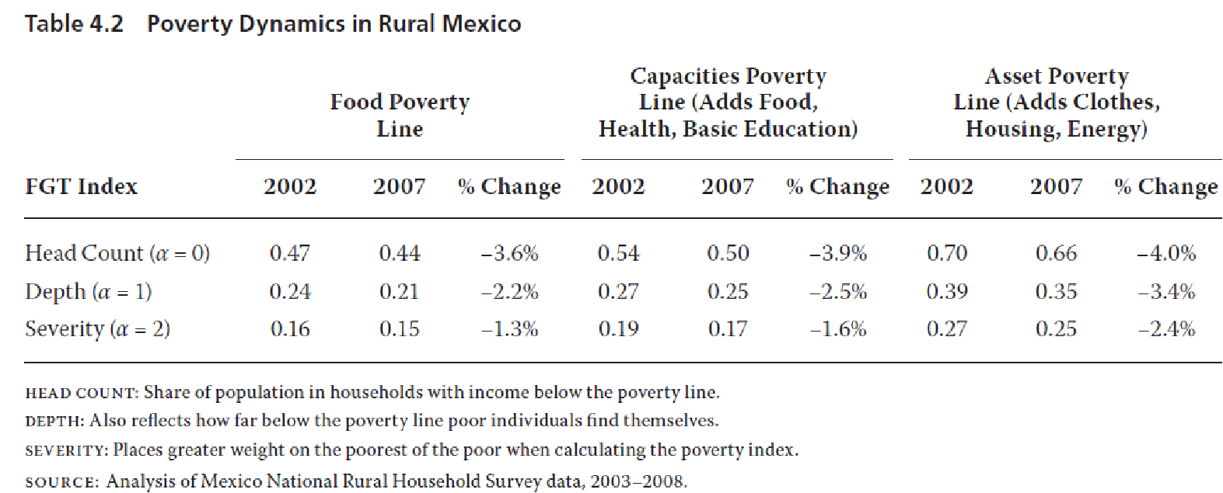

Slide 12
Convex Asset Growth Curve
A_{t+1}: Assets next year
A_{t}: Assets this year

Slide 13
Convex Asset Growth Curve with Steady-state at B
A_{t+1}= A_{t} along 45° line
A_{t+1}: Assets next year
A_{t+1}> A_{t}
B
A_{t+1}< A_{t}
A_{t}: Assets this year
A*

Slide 14
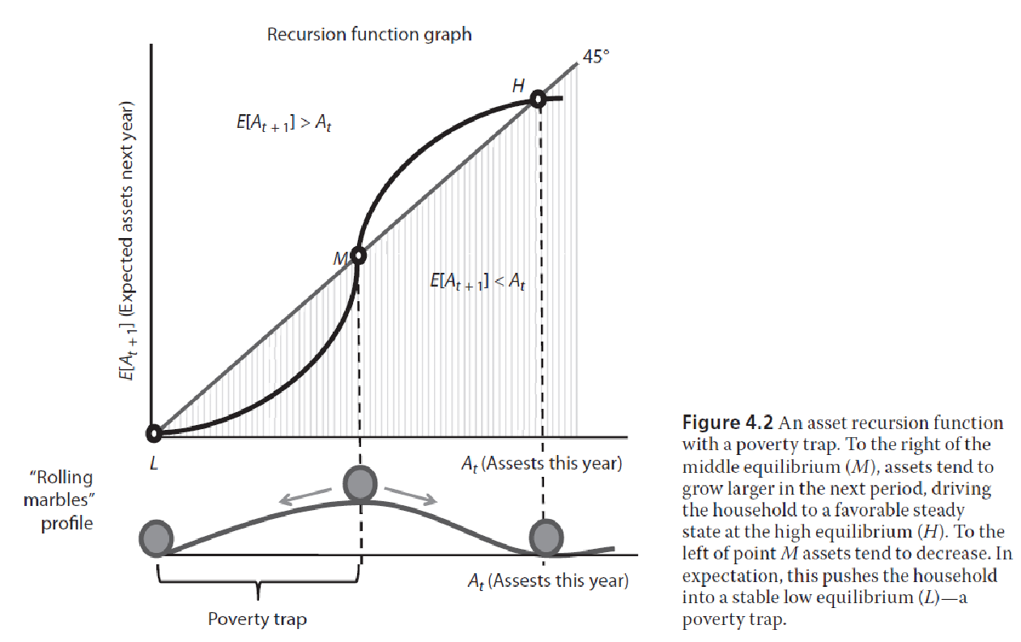
Non-convex Asset Growth and the Poverty Trap (Steady-states at B & 0)

